Slide 1

Graph
A non-linear data structure
Vinay Pratap Singh Sengar

Slide 2
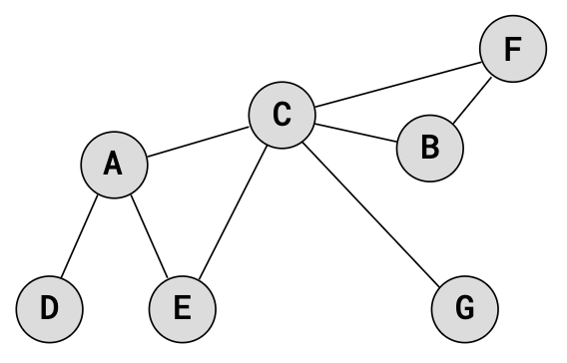
🌳 Introduction of Graph
Definition : A Graph is a non-linear data structure made of:
  Vertices (Nodes) → (represent objects) Vertices are the fundamental units of the graph. Sometimes, vertices are also known as vertex or nodes. Every node/vertex can be labeled or unlabelled.
  Edges (Connections) → represent relationships between objects. Vertices are the fundamental units of the graph. Sometimes, vertices are also known as vertex or nodes. Every node/vertex can be labeled or unlabelled.
👉 A Graph is written as G(V, E)
      V = set of vertices
      E = set of edges
Example:
In football → players = nodes, passes/interactions = edges.

Slide 3
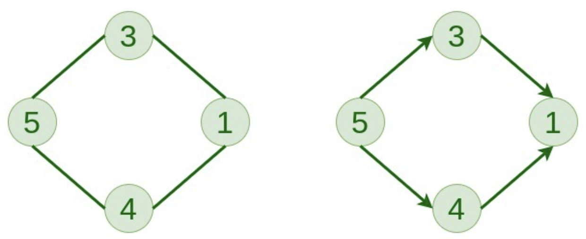
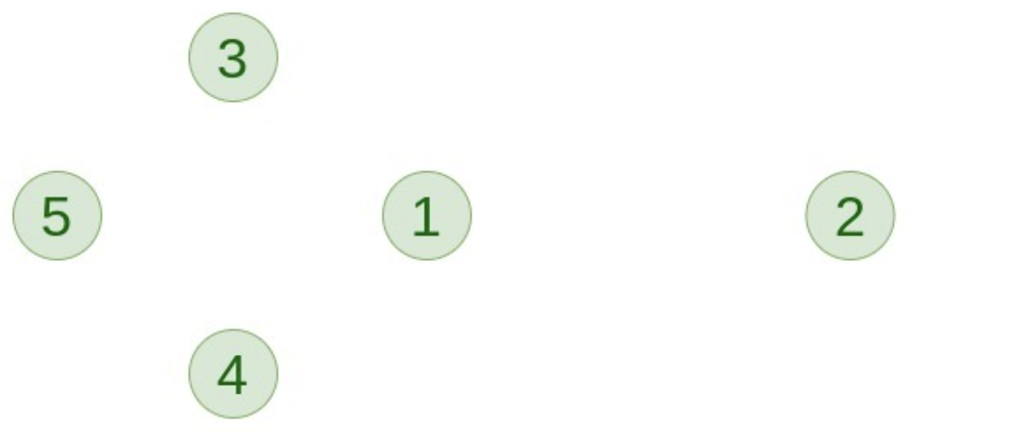
Types of Graphs
1. Null Graph :
  A Graph is known as null graph if there are no edges in the graph.
2. Trivial Graph :
  A Graph having only the single vertex, it is also the smallest graph possible.
3. Undirected Graph :
  A Graph which edge do not have any direction.
  If an edge exists between vertex A and B then the vertices can be traversed from B to A as well as A to B.
4. Directed Graph :
        In a directed graph, edges form an ordered pair. Edges represent a specific path from some vertex A to another vertex B.
        Node A is called initial node while node B is called terminal node.
Undirected Graph
Directed Graph
Trivial Graph
Null Graph

Slide 4
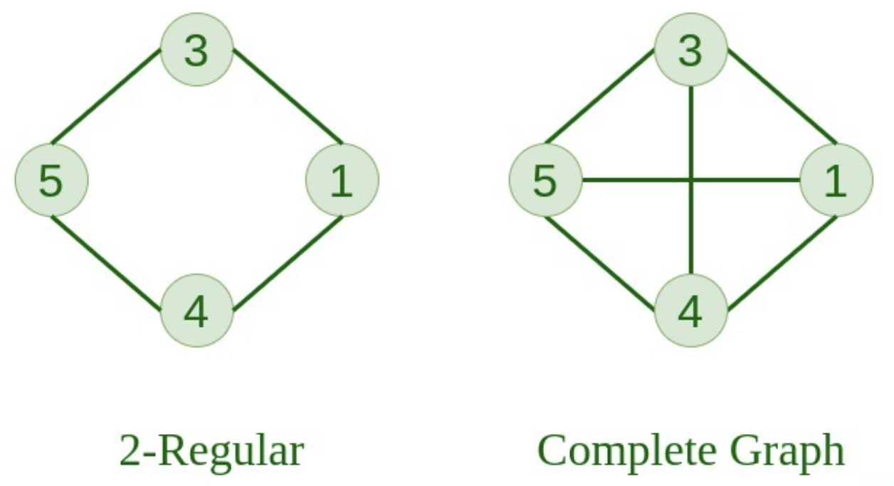
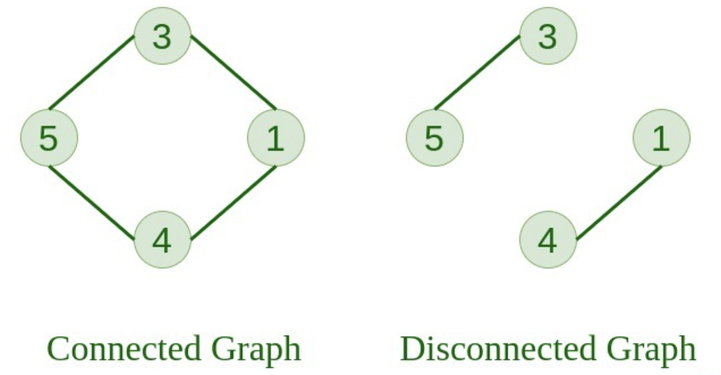
Types of Graph
5. Connected Graph :
  The graph in which from one node we can visit any other node in the graph is known as a connected graph.
6. Disconnected Graph :
    The graph in which at least one node is not reachable from a node is known as a disconnected graph.
7. Regular Graph :
  The graph in which from one node we can visit any other node in the graph is known as a connected graph.
8. Complete Graph :
    The graph in which from each node there is an edge to each other node.

Slide 5
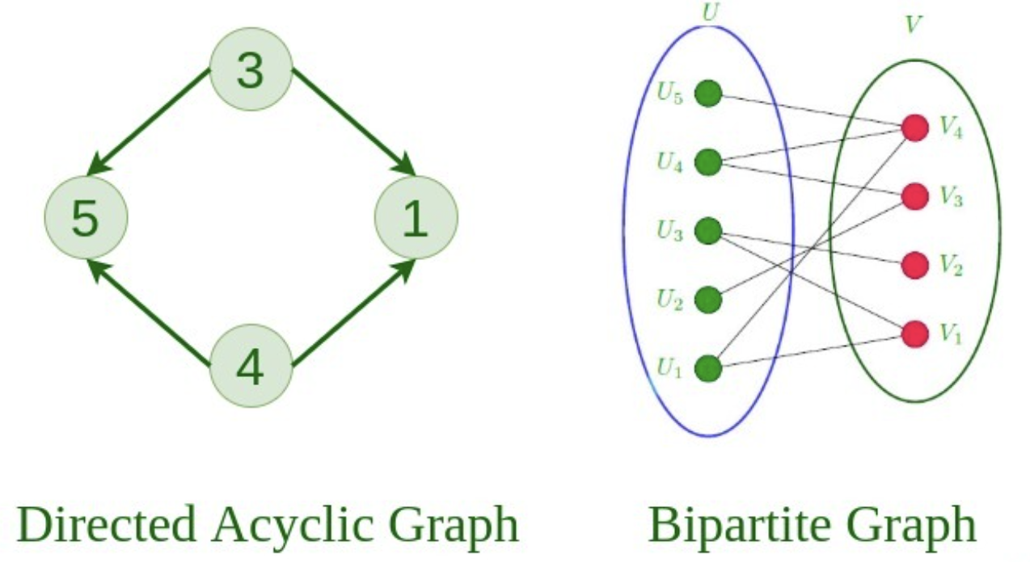
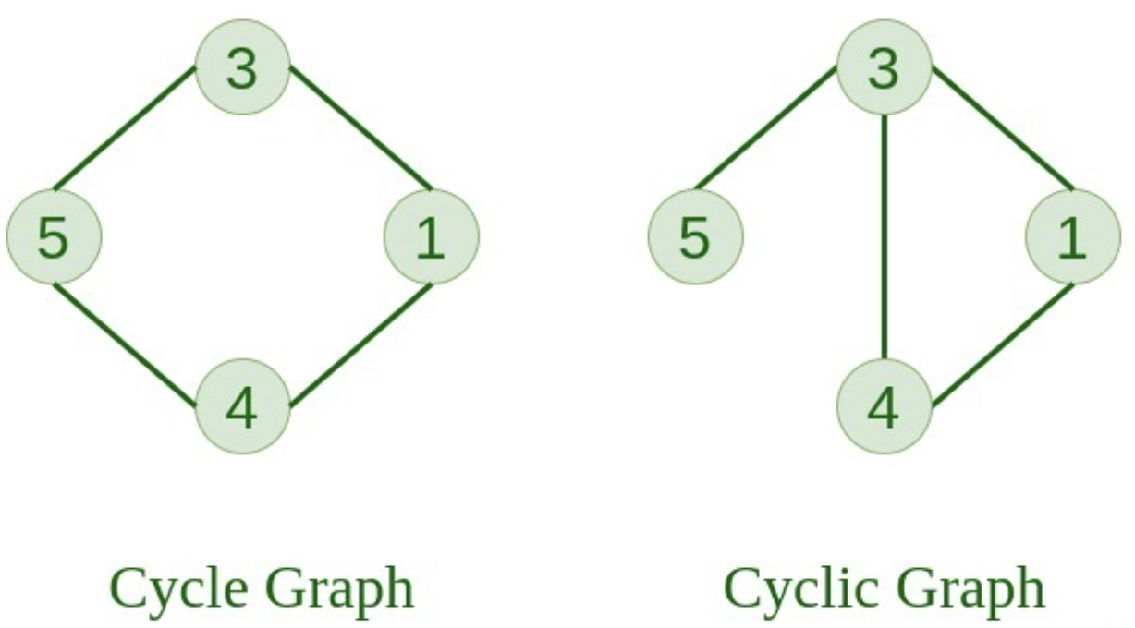
Types of Graph
9. Cycle Graph :
    The graph in which the graph is a cycle in itself, the minimum value of degree of each vertex is 2.
10. Cyclic Graph :
    A graph containing at least one cycle is known as a Cyclic graph.
11. Directed Acyclic Graph
    A Directed Graph that does not contain any cycle.
12. Bipartite Graph
  A graph in which vertex can be divided into two sets such that vertex in each set does not contain any edge between them.

Slide 6
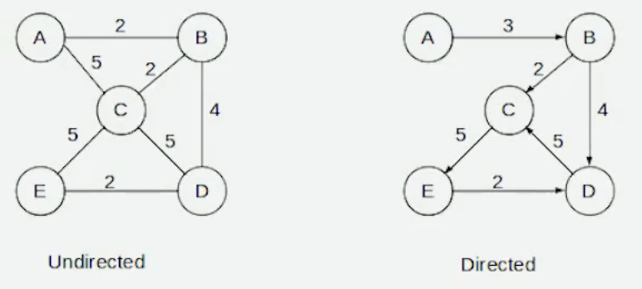
Types of Graph
13. Weighted Graph
    A graph in which the edges are already specified with suitable weight is known as a weighted graph.
    Weighted graphs can be further classified as directed weighted graphs and undirected weighted graphs.

Slide 7

Graph Terminology
1. Path
  A path can be defined as the sequence of nodes that are followed in order to reach some terminal node V from the initial node U.
  Example: If we move from A → B → C → D, then that is a path.
2. Closed Path
  A path will be called as closed path if the initial node is same as terminal node. A path will be closed path if V0=VN,.
  Example: A → B → C → A
3. Simple Path
  A path in which all nodes are different (except the first and last if it’s closed).
  If all the nodes of the graph are distinct with an exception V0=VN, then such path P is called as closed simple path.
  Example: A → B → C → D (all unique).
  Closed Simple Path: A → B → C → A

Slide 8
Graph Terminology
4. Cycle
  A cycle can be defined as the path which has no repeated edges or vertices except the first and last vertices.
  Example: A → B → C → A
5. Connected Graph
  A connected graph is the one in which some path exists between every two vertices (u, v) in V. There are no isolated nodes in connected graph..
6. Complete Graph
  A complete graph is the one in which every node is connected with all other nodes.
  A complete graph contain n(n-1)/2 edges where n is the number of nodes in the graph.
7. Weighted Graph
  In a weighted graph, each edge is assigned with some data such as length or weight.
  The weight of an edge e can be given as w(e) which must be a positive (+) value indicating the cost of traversing the edge.

Slide 9
Graph Terminology
4. Diagraph
  A digraph is a directed graph in which each edge of the graph is associated with some direction and the traversing can be done only in the specified direction.
5. Loop
  An edge that is associated with the similar end points can be called as Loop..
6. Adjacent Node
  If two nodes u and v are connected via an edge e, then the nodes u and v are called as neighbours or adjacent nodes..
7. Degree of the Node
  A degree of a node is the number of edges that are connected with that node.
  A node with degree 0 is called as isolated node.

Slide 10
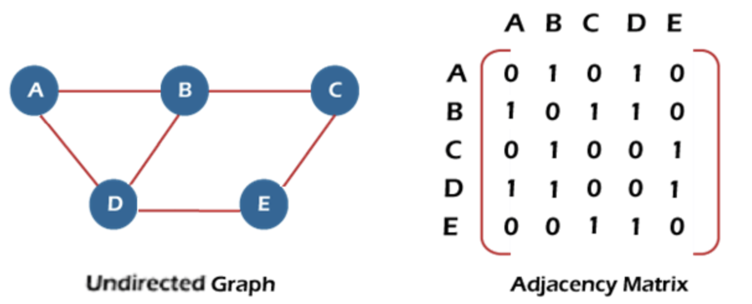
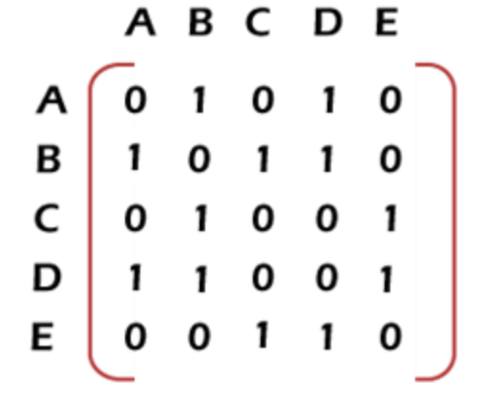
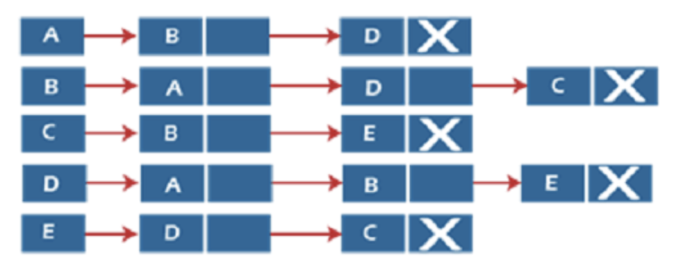
Graph Representation
What is Graph Representation :
    Graph representation = how we store a graph in memory.
    There are 2 main ways :
      Adjacency Matrix (Sequential representation)
      Adjacency List (Linked representation)
Adjacency Matrix
Adjacency List

Slide 11
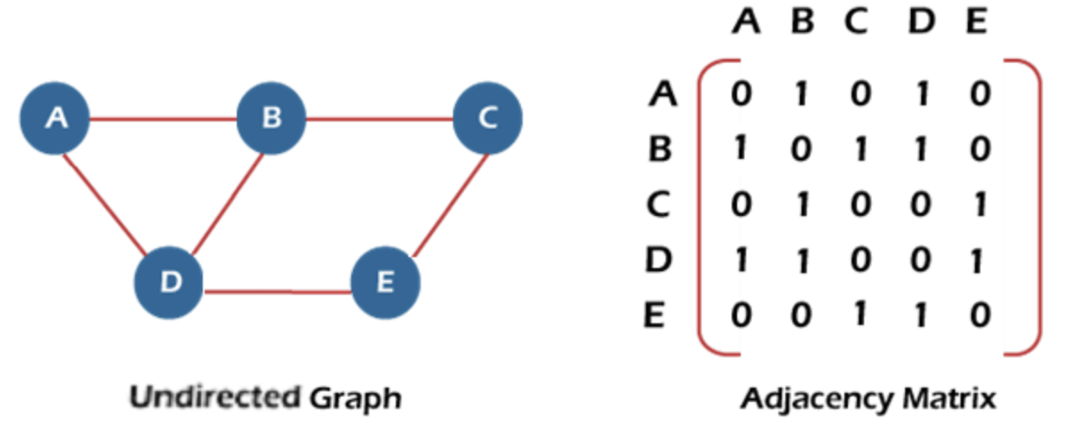
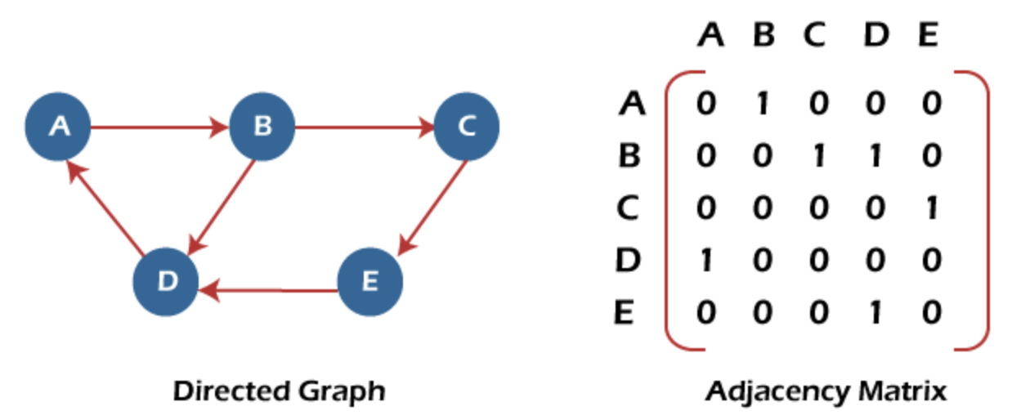
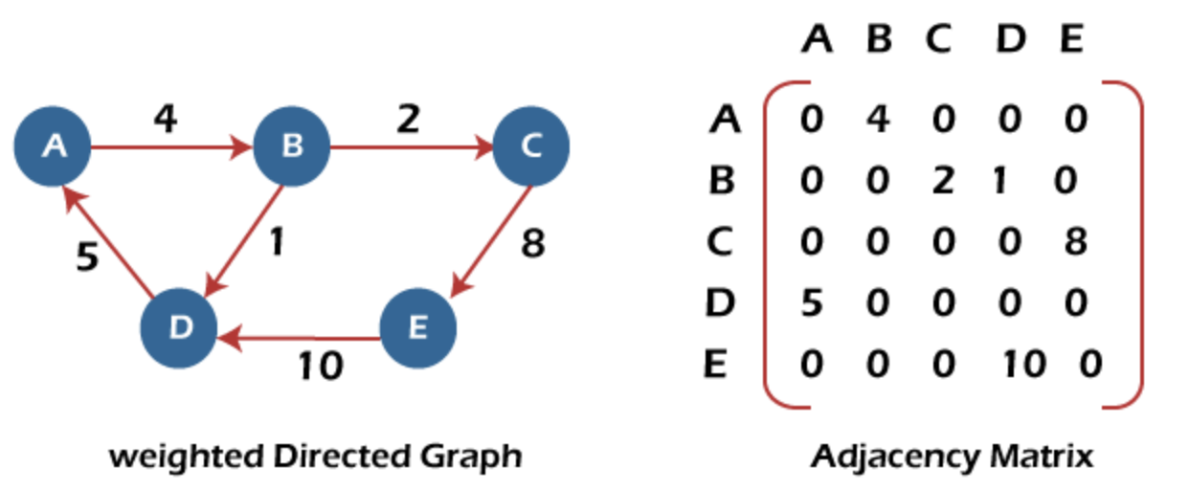
Sequential Representation of Graph
Adjacency Matrix for Undirected Graph :
Adjacency Matrix for Weighted Directed Graph :
Adjacency Matrix for Directed Graph
In a directed graph, edges represent a specific path from one vertex to another vertex.
Suppose a path exists from vertex A to another vertex B; it means that node A is the initial node, while node B is the terminal node.
In the above graph, we can see there is no self-loop, so the diagonal entries of the adjacent matrix are 0.

Slide 12
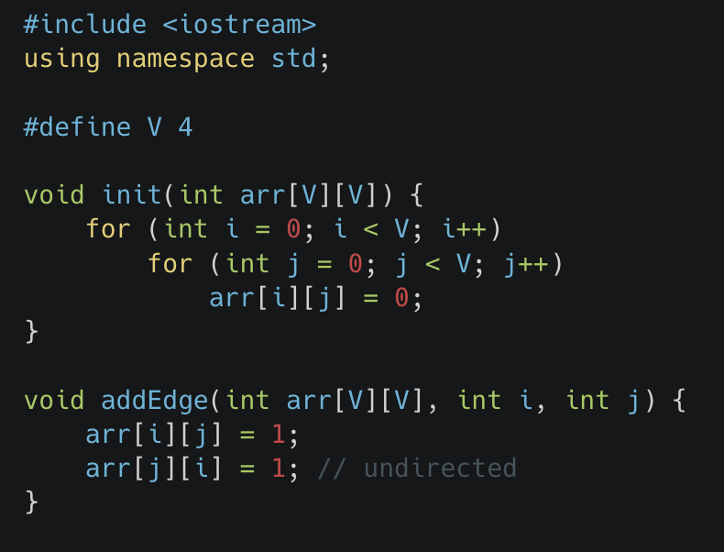
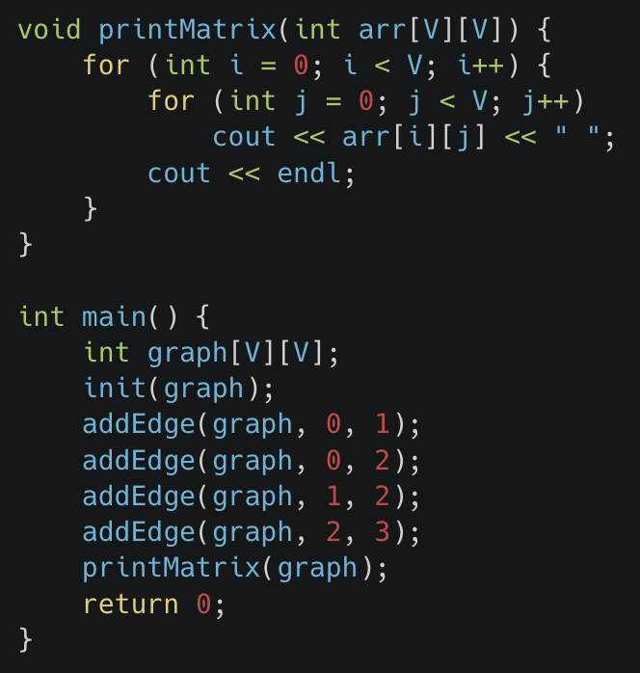
Implementation of Adjacency Matrix Representation of Graph

Slide 13
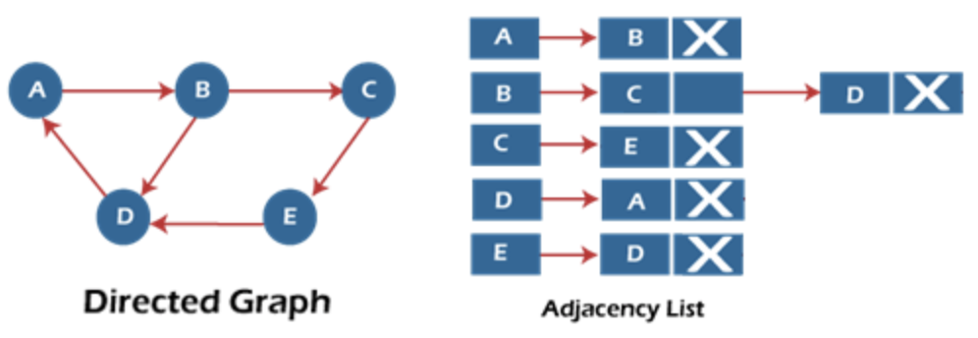
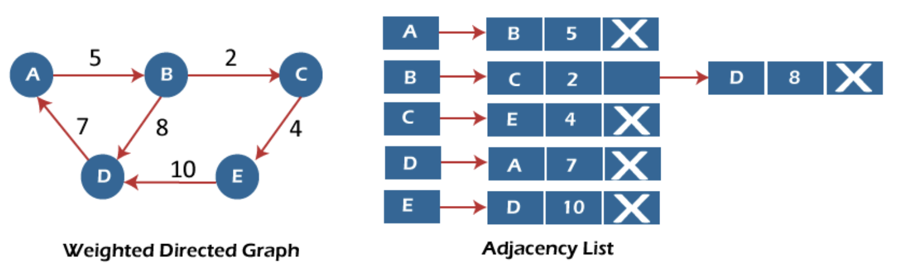
Linked List Representation of Graph
Adjacency List Representaion for Directed Graph :
Adjacency List Representaion for Weighted Directed Graph :

Slide 14
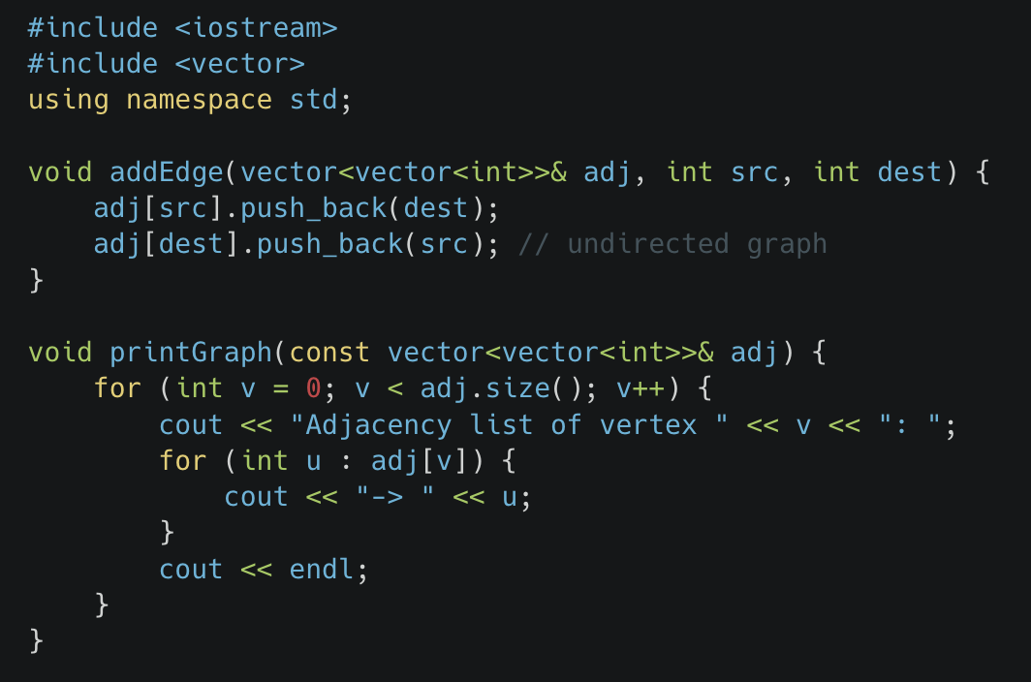
Implementation of Adjacency List Representation of Graph

Slide 15
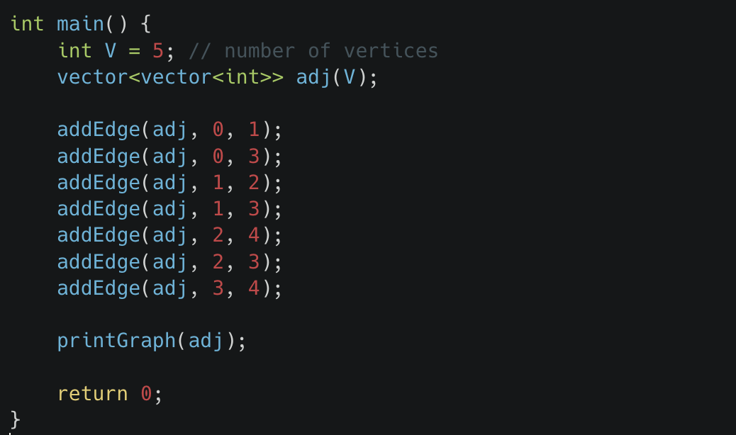
Implementation of Adjacency List Representation of Graph

Slide 16
BFS Traversal Algorithm
1. Definition :
  Breadth-first search is a graph traversal algorithm that starts traversing the graph from the root node and explores all the neighboring nodes. it selects the nearest node and explores all the unexplored nodes.
  While using BFS for traversal, any node in the graph can be considered as the root node.
  There are many ways to traverse the graph, but among them, BFS is the most commonly used approach. It is a recursive algorithm to search all the Each of a tree or graph data structure.
  BFS puts every vertex of the graph into two categories - visited and non-visited. It selects a single node in a graph and, after that, visits all the nodes adjacent to the selected node.
2. Application of BFS :
      Each Find shortest path in an unweighted graph.
      Used in Google Maps to find nearby places.
      Used in Web Crawlers (search engines).
      Used in Network Flow algorithms (Ford-Fulkerson).
      Used in Peer-to-Peer Networks (like BitTorrent).
      Used in Garbage Collection (Cheney’s algorithm).

Slide 17
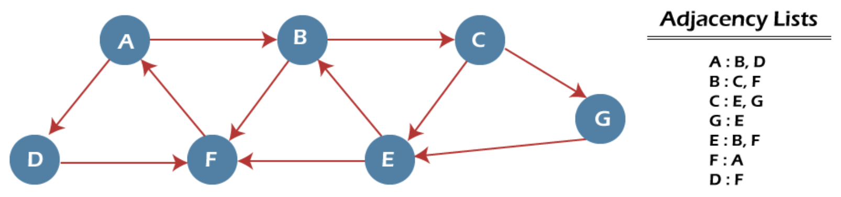
Example of BFS Algorithm
We have a graph with 7 vertices.
We start BFS from Node A and want to reach Node E.
We will use:
Queue1 → Nodes to be processed (waiting).
Queue2 → Nodes already processed (visited).
Step 1 :
Add starting node A to Queue1.
    Queue1 = {A}
    Queue2 = { }
Step 2 :
Remove A from Queue1 → move to Queue2.
Add A’s neighbors (B, D) to Queue1.
  Queue1 = {B, D}
  Queue2 = {A}
Step 3 :
Remove B → move to Queue2.
Add B’s neighbors (C, F) to Queue1.
Queue1 = {D, C, F}
Queue2 = {A, B}
Step 4 :
Remove D → move to Queue2.
Add D’s neighbor (F). But F already exists → not added again.
  Queue1 = {C, F}
  Queue2 = {A, B, D}
Step 5
Remove C → move to Queue2.
Add C’s neighbors (E, G).
Queue1 = {F, E, G}
Queue2 = {A, B, D, C}
Step 6
Remove F → move to Queue2.
F’s neighbors already present → no new insert.
Queue1 = {E, G}
Queue2 = {A, B, D, C, F}
Step 7
Remove E → move to Queue2.
Neighbors already present.
We have reached target node E
Queue1 = {G}
Queue2 = {A, B, D, C, F, E}
🔹 Final Order of Visit : A → B → D → C → F → E → G

Slide 19
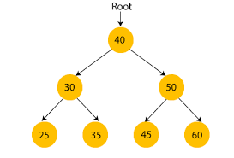
Binary Search Tree
1. Definition
    A special type of binary tree where:
      The left child contains values less than the parent.
      The right child contains values greater than the parent.
    No duplicate values (usually).
2. Properties
        Left < Root < Right (ordering property).
        An inorder traversal of a BST always gives elements in sorted order.
        Efficient for searching, insertion, deletion.
3. Operations
    Search: Start at root → go left if key is smaller, right if key is larger.
    Insertion: Place new node in correct position (left/right).
    Deletion:
      If node is leaf → simply remove.
      If node has one child → replace with child.
      If node has two children → replace with inorder successor/predecessor.
4. Complexity
        Best / Average case: O(log n) (balanced tree).
        Worst case: O(n) (skewed tree, like a linked list).

Slide 20
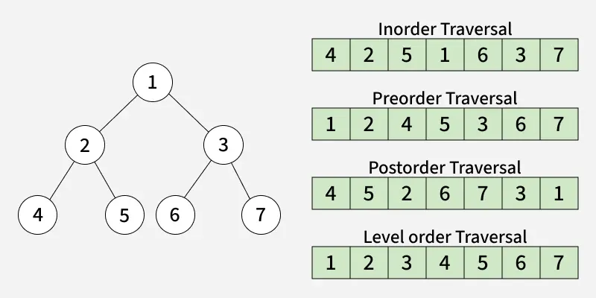
Tree Traversal
Depth-First Traversals (DFS):
  Preorder (Root → Left → Right)
  Inorder (Left → Root → Right)
  Postorder (Left → Right → Root)
Breadth-First Traversal (BFS):
  Level Order Traversal using Queue.

Slide 21
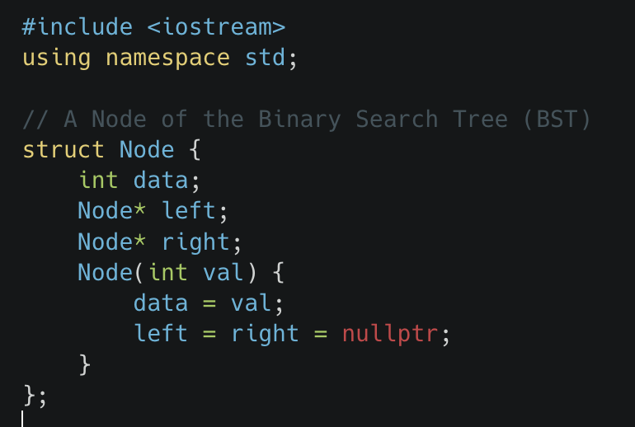
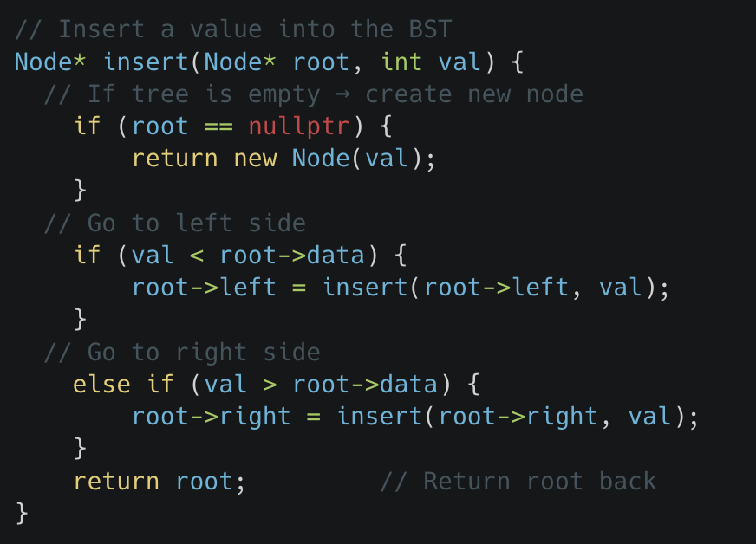
Binary Search Tree Implementation

Slide 22
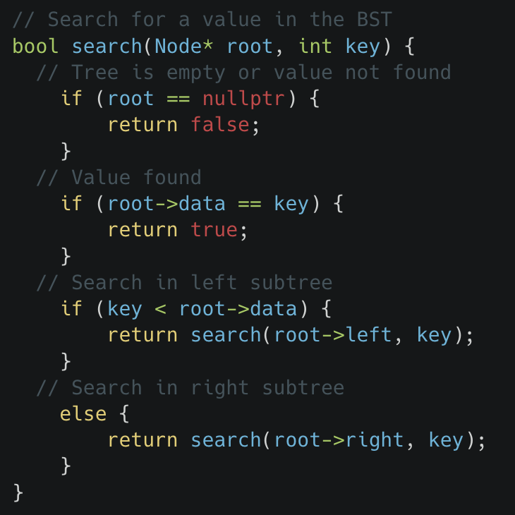
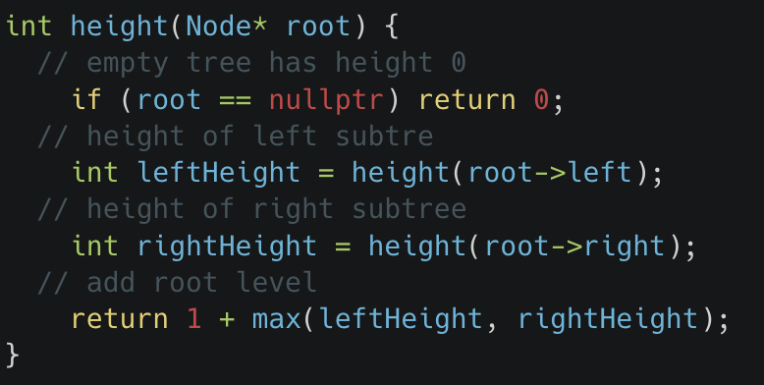
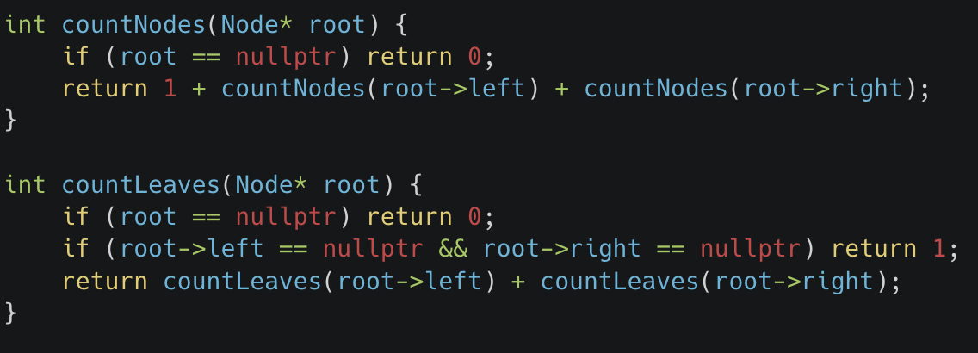
Basic Operations in BST

Slide 23
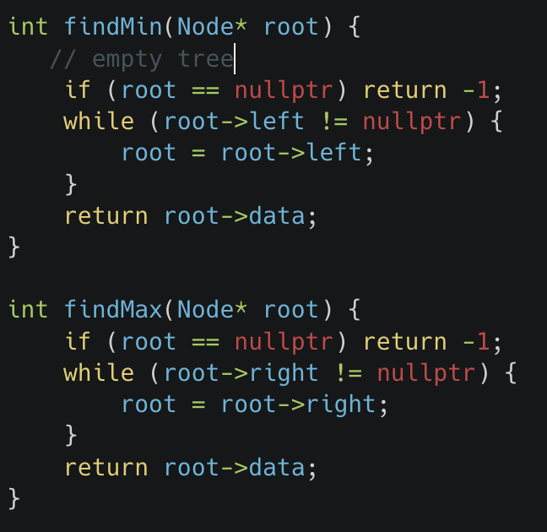
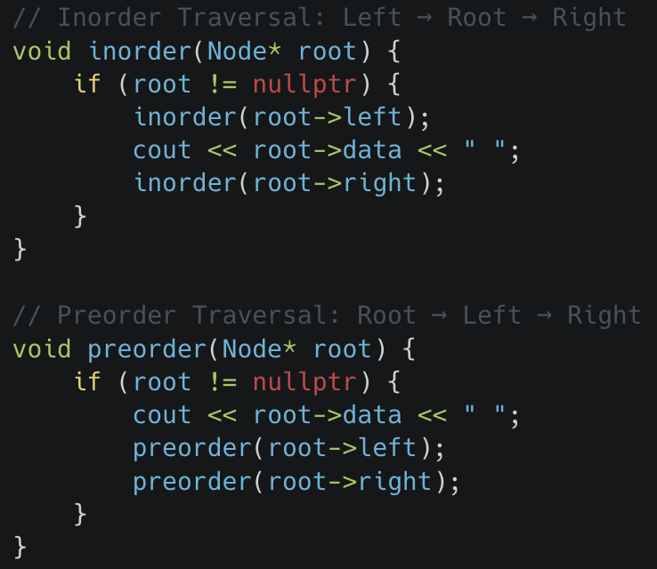
Basic Operations in BST

Slide 24
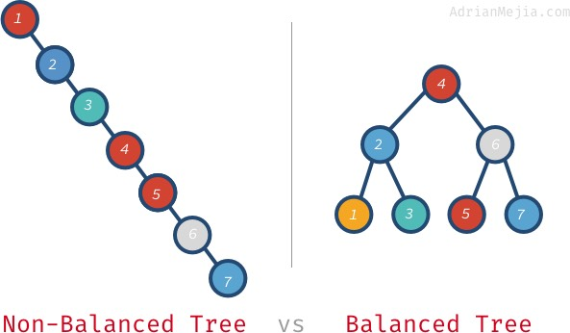
Balanced vs Non-Balanced Binary Tree
1. Non-Balanced Binary Tree
A tree becomes unbalanced when many nodes pile up on one side (like a linked list).
Example: Inserting sorted data (1, 2, 3, 4, …) into a plain BST without balancing.
👉 Performance:
Searching, inserting, or deleting degrades to O(n).
With 1,000,000 nodes → could take 1,000,000 steps.
2. Balanced Binary Tree
A binary tree is balanced if, for every node, the heights of its left and right subtrees differ by at most 1.
This ensures the tree doesn’t lean too much in one direction.
Common self-balancing trees: AVL Tree, Red-Black Tree.
👉 Performance:
Searching, inserting, or deleting takes O(log n) time.
With 1,000,000 nodes → about 20 steps (since log₂(1,000,000) ≈ 20).
Why Balance Matters
Balanced = Efficient (logarithmic time).
Unbalanced = Inefficient (linear time).
Huge difference at scale: 20 steps vs. 1,000,000 steps!

Slide 25
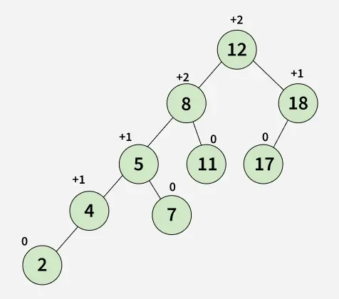
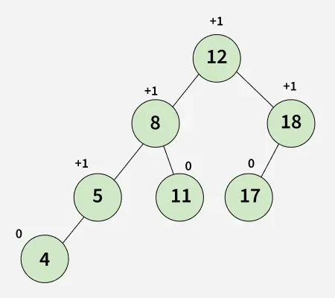
How to find Balance Factor
For any node, compute:
balanceFactor = height(left subtree) - height(right subtree)
If balanceFactor is –1, 0, or +1, the node is balanced.
If outside this range, the node (and hence the tree) is unbalanced.
Unbalanced Tree
Balanced Tree

Slide 26
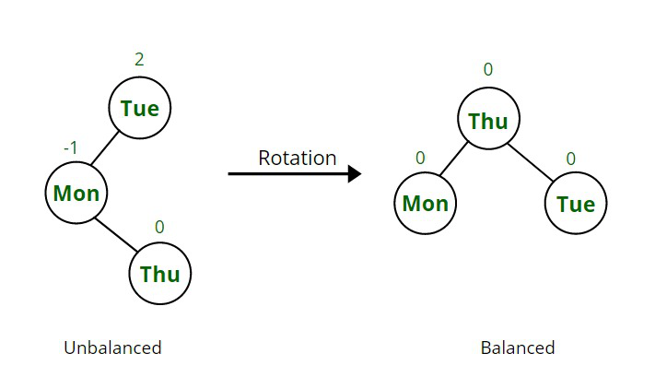
AVL Tree
Definition
AVL Tree is a self-balancing BST.
Named after its inventors: Adelson-Velsky and Landis (1962).
Balance Condition: For every node,
| height(left subtree) – height(right subtree) | ≤ 1
Why AVL Trees?
Ensures the tree never becomes skewed (like a linked list).
Guarantees O(log n) time complexity for:
  Search
  Insert
  Delete
Use Cases
When fast lookups are critical:
  Database indexing
  Memory-intensive applications
  Scenarios requiring predictable, worst-case performance

Slide 27
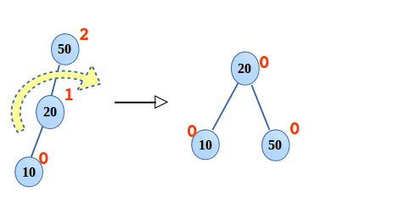
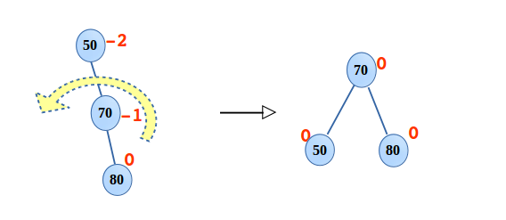
Rotation in AVL Tree
1. Right rotation(RR)
  In the binary search tree shown below is a case of right rotation. There is a single rotation required at the root 50, done as followed,
  20 will be the new root.
  50 takes ownership of 20’s right child,
  10 is still the left child of 20.
2. Left rotation(LL)
In the binary search tree shown below is a case of left rotation where required. There is a single rotation required at the root 50, done as followed,
70 will be the new root.
50 takes ownership of 70’s left child.
80 is still the right child of 70.

Slide 28
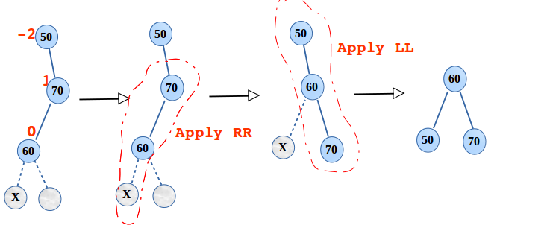
Rotation in AVL Tree
3. Left right double rotation(LR)
  Shown below is the case of LR rotation, here two rotations are performed. First RR and then, LL as follows,
  Right rotation is applied at 70, after restructuring, 60 takes the place of 70 and 70 as the right child of 60.
  Now left rotation is required at the root 50, 60 becomes the root. 50 and 70 become the left and right child respectively.

Slide 29
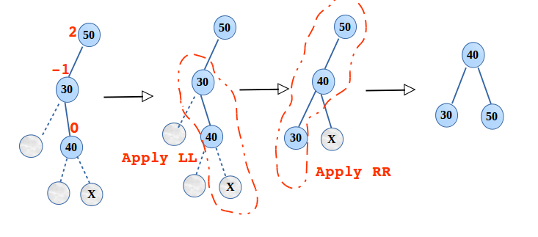
Rotation in AVL Tree
4. Right left double rotation(RL)
  Shown below is the case of RL rotation, here two rotations are performed. First LL and then, RR as follows,
  Left rotation is applied at 30, after restructuring 40 takes the place of 30 and 30 as the left child of 40.
  Now right rotation is required at the root 50, 40 becomes root. 30 and 50 becomes the left and right child respectively

Slide 30
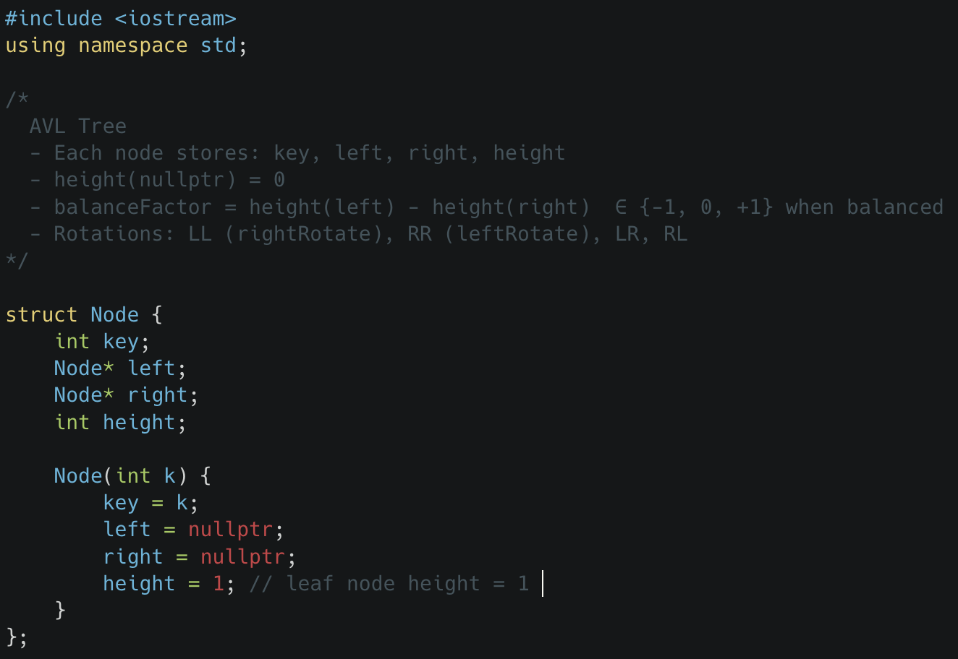
AVL Tree Implementation

Slide 31
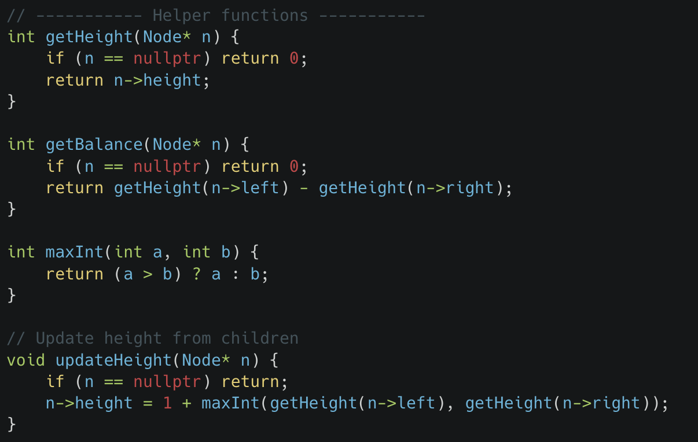
Helper functions Implementation in AVL Tree

Slide 32
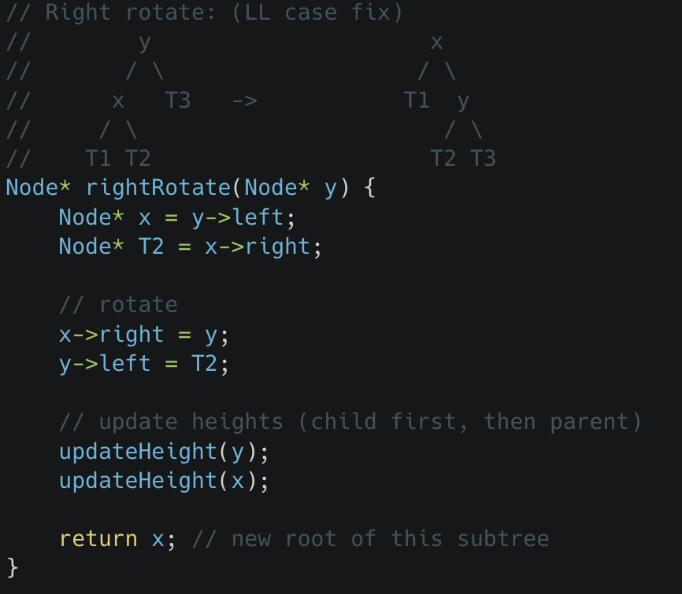
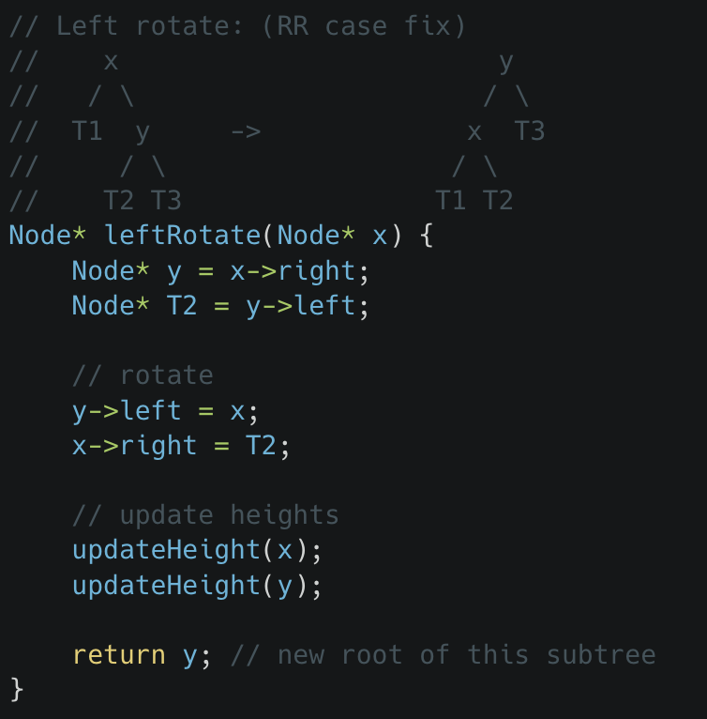
AVL Tree Rotations

Slide 33
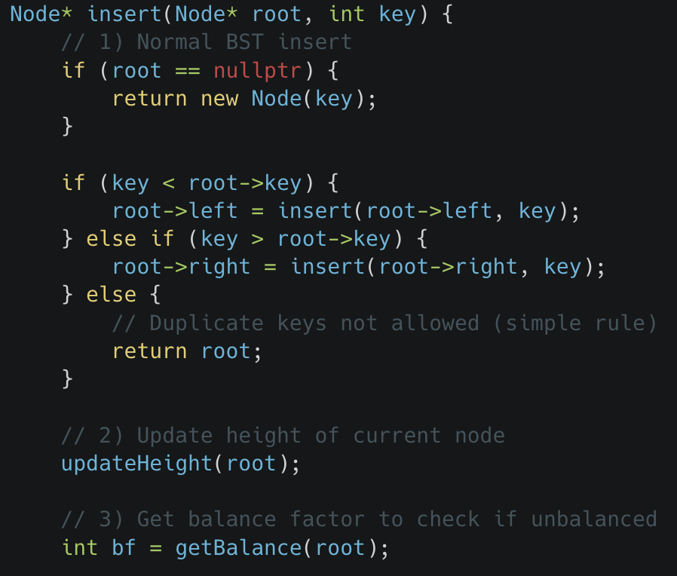
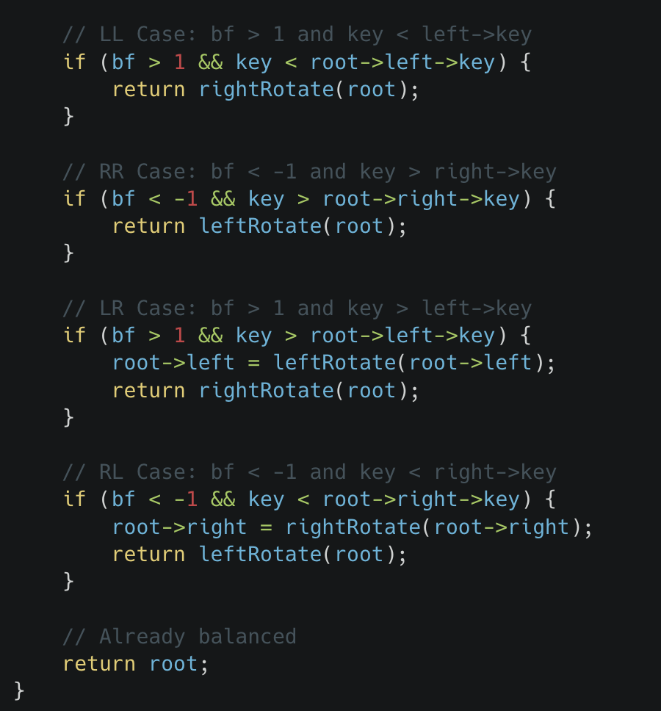
AVL Tree Rotations

Slide 34
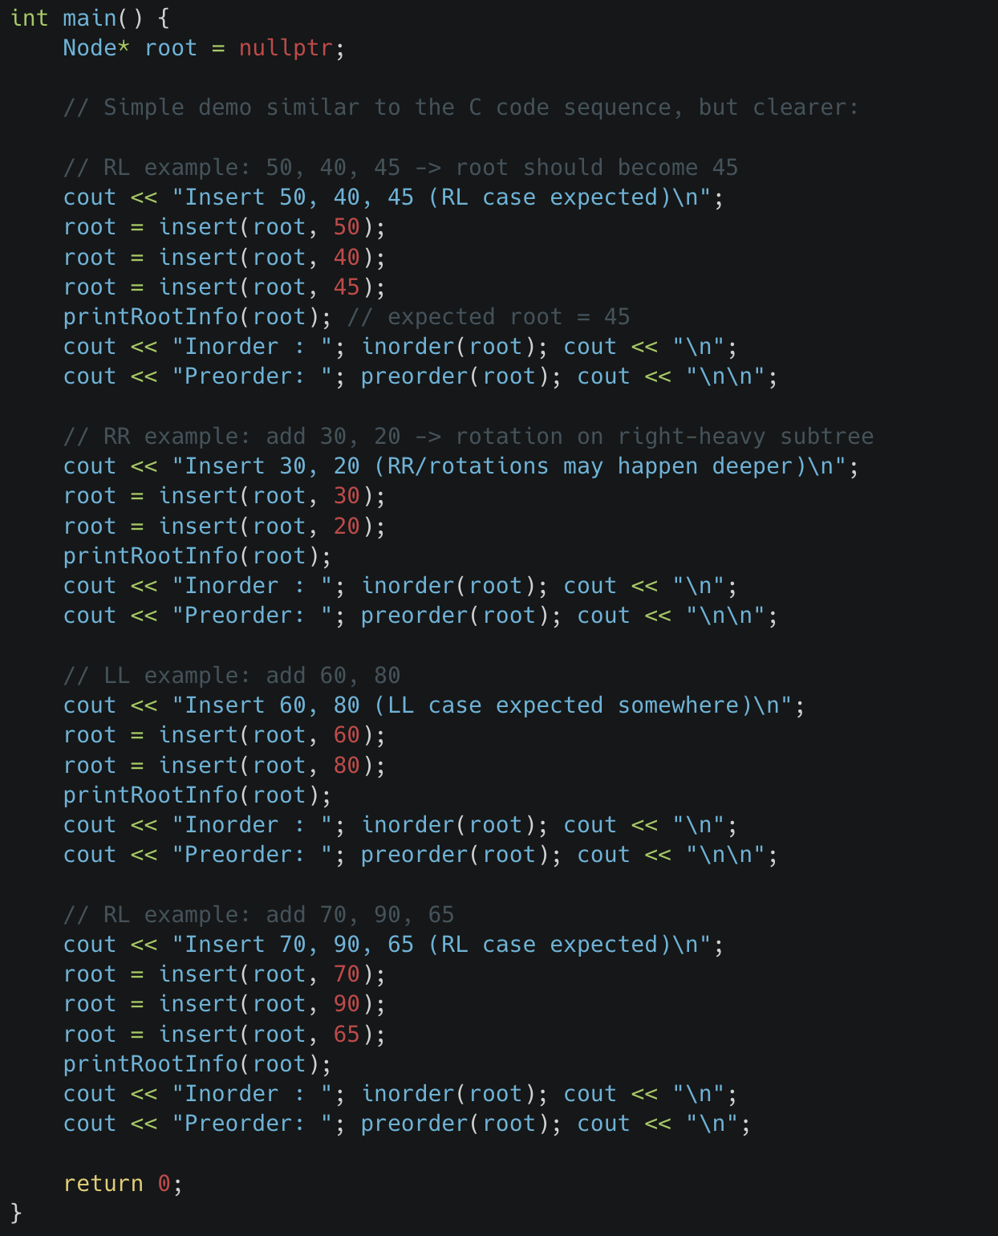

Slide 35
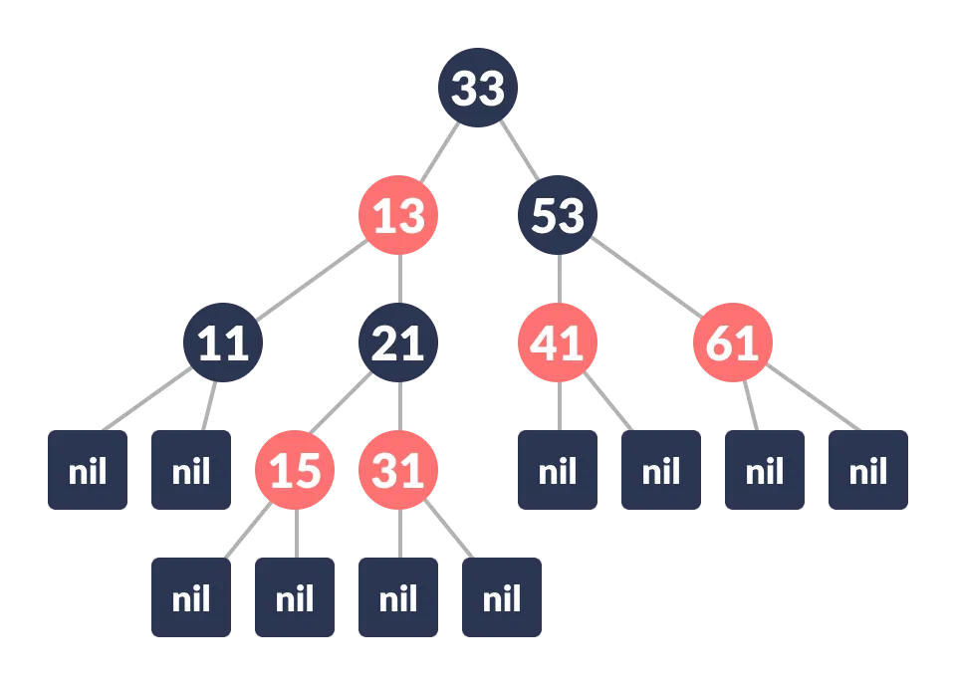
Red black Tree
Definition :
  Red-Black tree is a self-balancing binary search tree in which each node contains an extra bit for denoting the color of the node, either red or black.
A red-black tree satisfies the following properties:
Red/Black Property: Every node is colored, either red or black.
Root Property: The root is black.
Leaf Property: Every leaf (NIL) is black.
Red Property: If a red node has children then, the children are always black.
Depth Property: For each node, any simple path from this node to any of its descendant leaf has the same black-depth (the number of black nodes).
Red Black Tree

Slide 36
Attributes of a Node in a Red-Black Tree
  Each node in a Red-Black Tree has the following attributes:
      color → either Red or Black
      key → the value stored in the node
      leftChild → pointer/reference to the left child
      rightChild → pointer/reference to the right child
      parent → pointer/reference to the parent node (except for the root node, which has no parent)
How a Red-Black Tree Maintains Self-Balancing
        The red/black colors of nodes are not just for labeling—they are used to maintain balance in the tree
        The color rules (properties) restrict how nodes can be arranged.
👉 Because of these restrictions:
      Any path from the root to a leaf (NIL) will never be more than twice as long as any other root-to-leaf path.
      This guarantee ensures that the height of the tree is always O(log n).
      As a result, operations like search, insert, and delete remain efficient.

Slide 37
Operations on a Red-Black Tree
Red-Black Trees support standard BST operations (search, insert, delete) but must also maintain the red-black properties. To enforce these, certain balancing operations are performed.
🔄 Rotation Operations
Rotations are used to rearrange the nodes of a subtree when any red-black property is violated.
Purpose: Maintain balance of the tree after insertion or deletion.
Types:
  Left Rotation
  Right Rotation
  Left-Right Rotation
  Right-Left Rotation

Slide 38
Application of Red-Black Trees
Red-Black Trees are widely used in real-world systems and libraries because they guarantee O(log n) time for search, insert, and delete.
📌 Common Applications :
  Finite Maps Implementation
  Used to efficiently store key–value pairs where quick lookups, insertions, and deletions are needed.
  Java Libraries
  Implemented in java.util.TreeMap and java.util.TreeSet to maintain sorted data with fast access.
  C++ STL (Standard Template Library)
    map
    multimap
    multiset
    These containers rely on Red-Black Trees internally.
  Linux Kernel
  Used in scheduling, memory management, and other subsystems to handle large dynamic data efficiently.

